Slide 1
LIBRARY MANAGEMENT PROJECT
GROUP MEMBERS:
BATIONO Jonathan
DIALLO Djénéba
GUISSO Ali
OUGDA Ibrahim
OUEDRAOGO Moumouni

Slide 2
JAVA FRONTEND

Slide 3
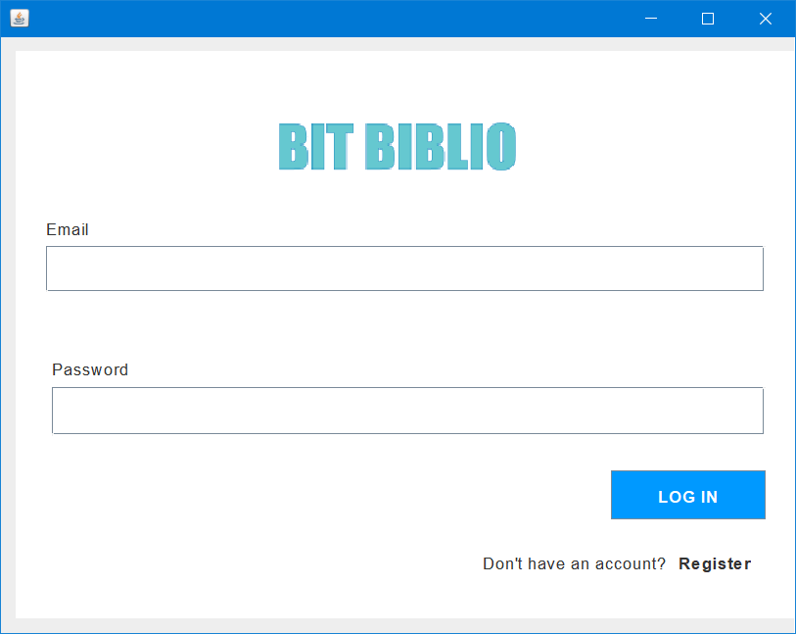
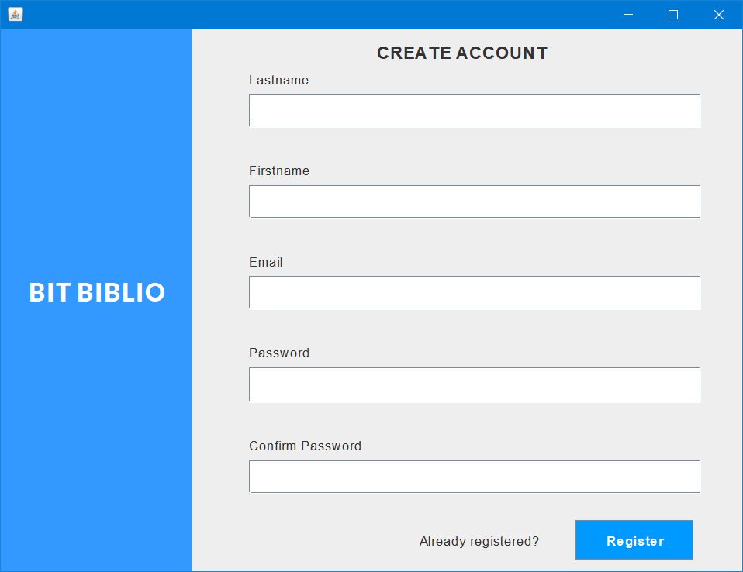
JAVA FRONTEND

Slide 4

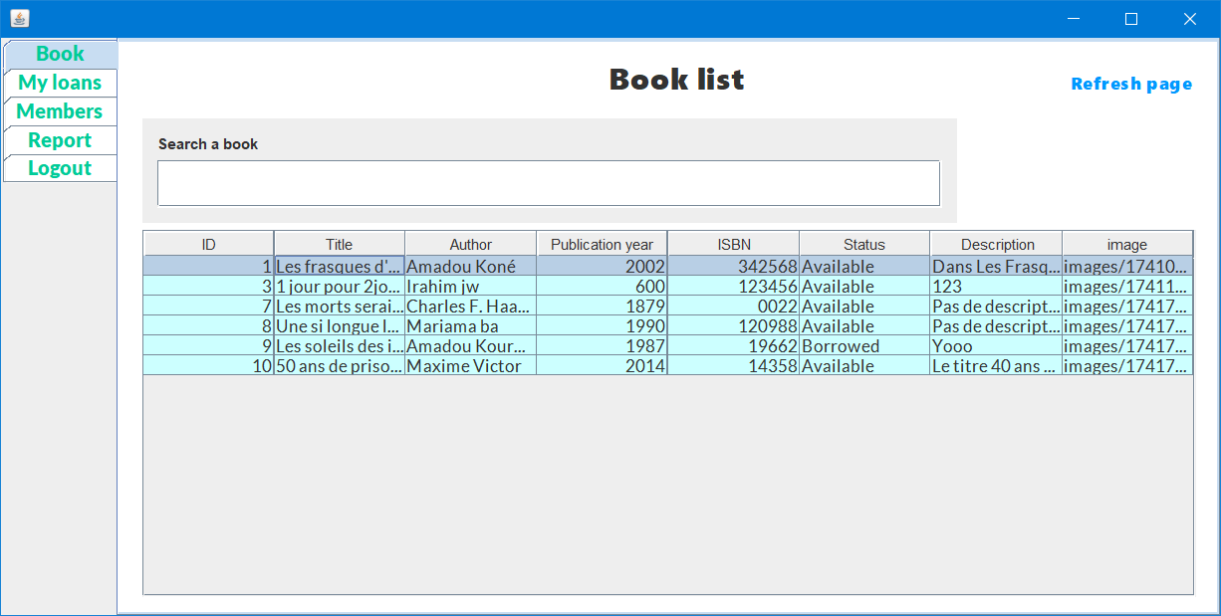
JAVA FRONTEND

Slide 5
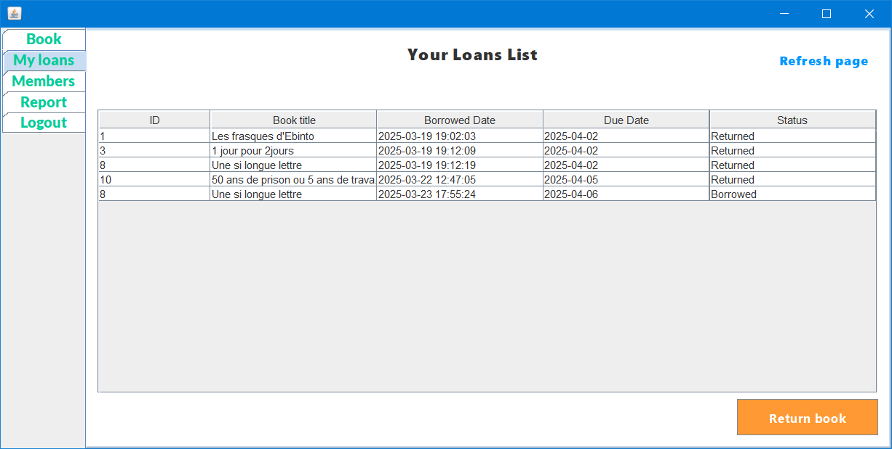
JAVA FRONTEND

Slide 6
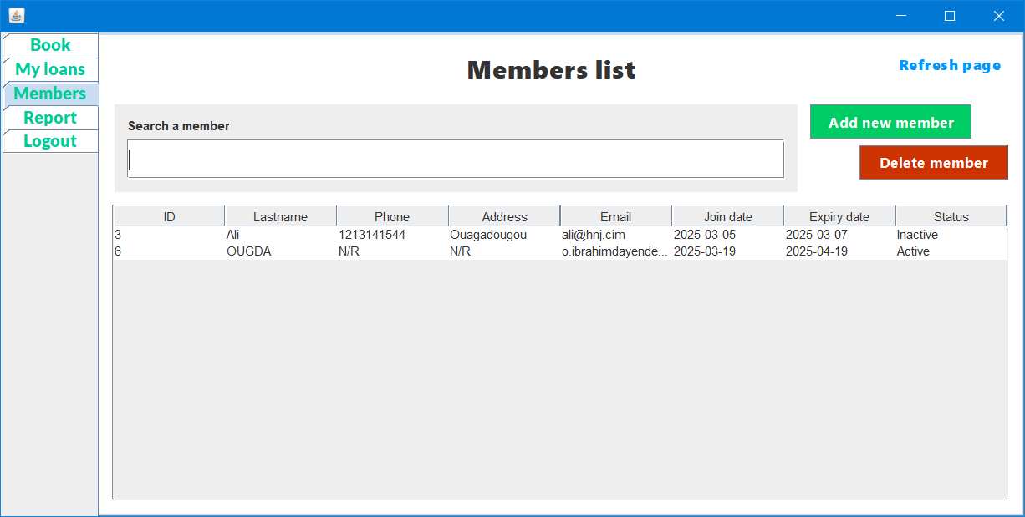
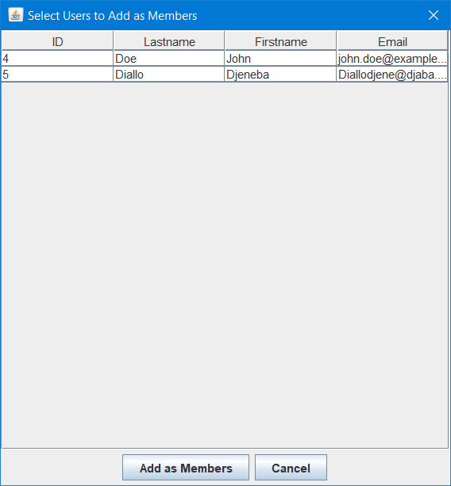
JAVA FRONTEND

Slide 7
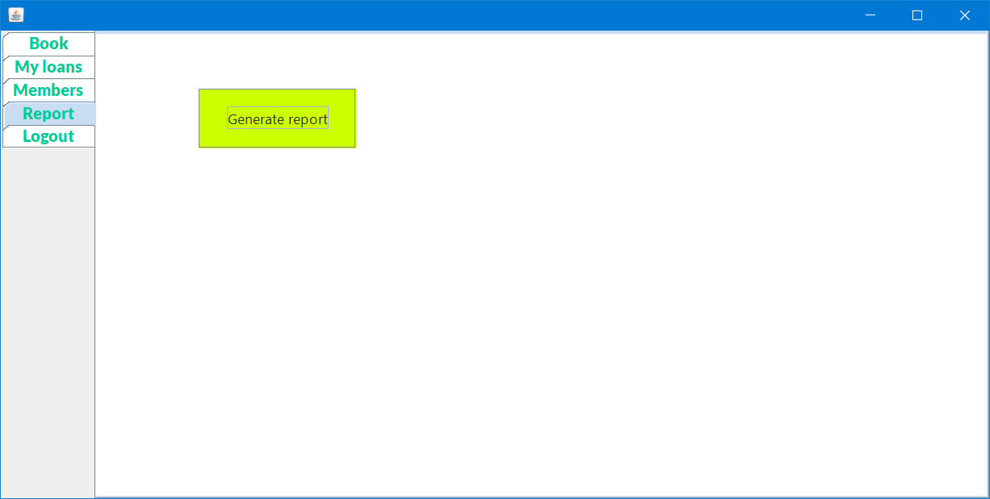
JAVA FRONTEND

Slide 8
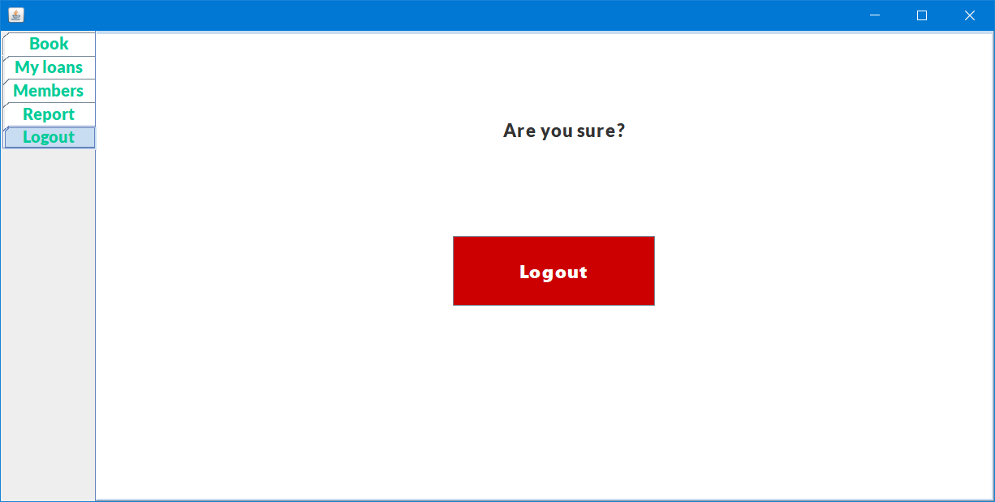
JAVA FRONTEND

Slide 9
LARAVEL BACKEND

Slide 10
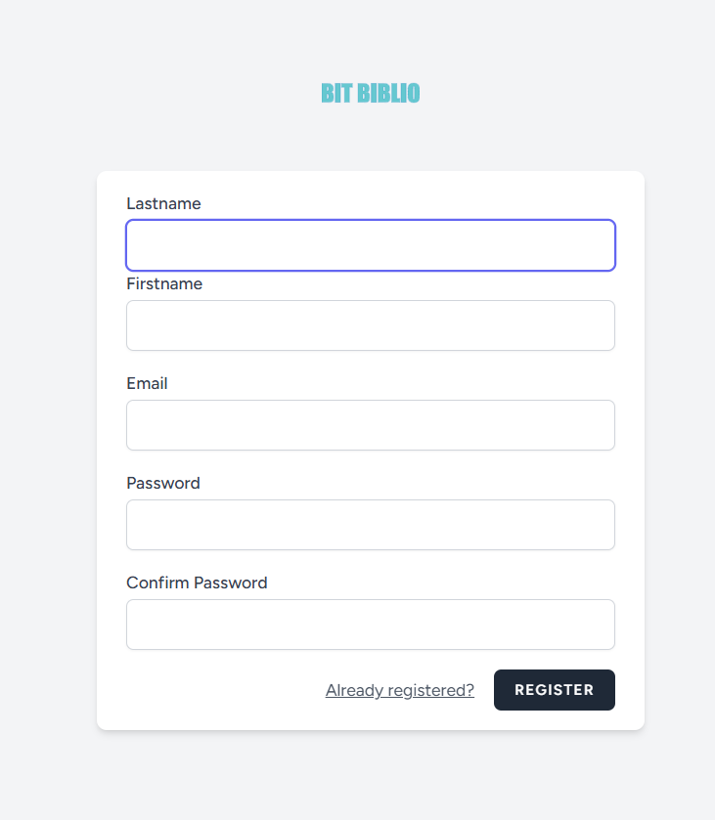
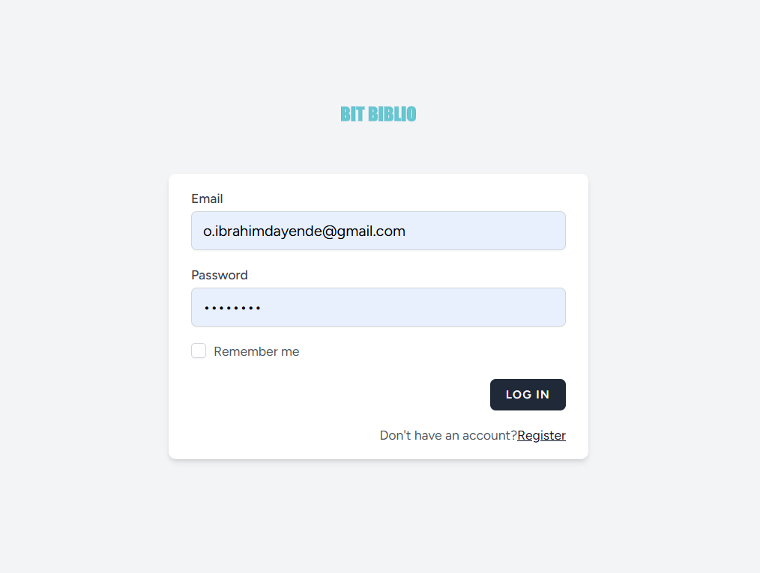
LARAVEL BACKEND

Slide 11
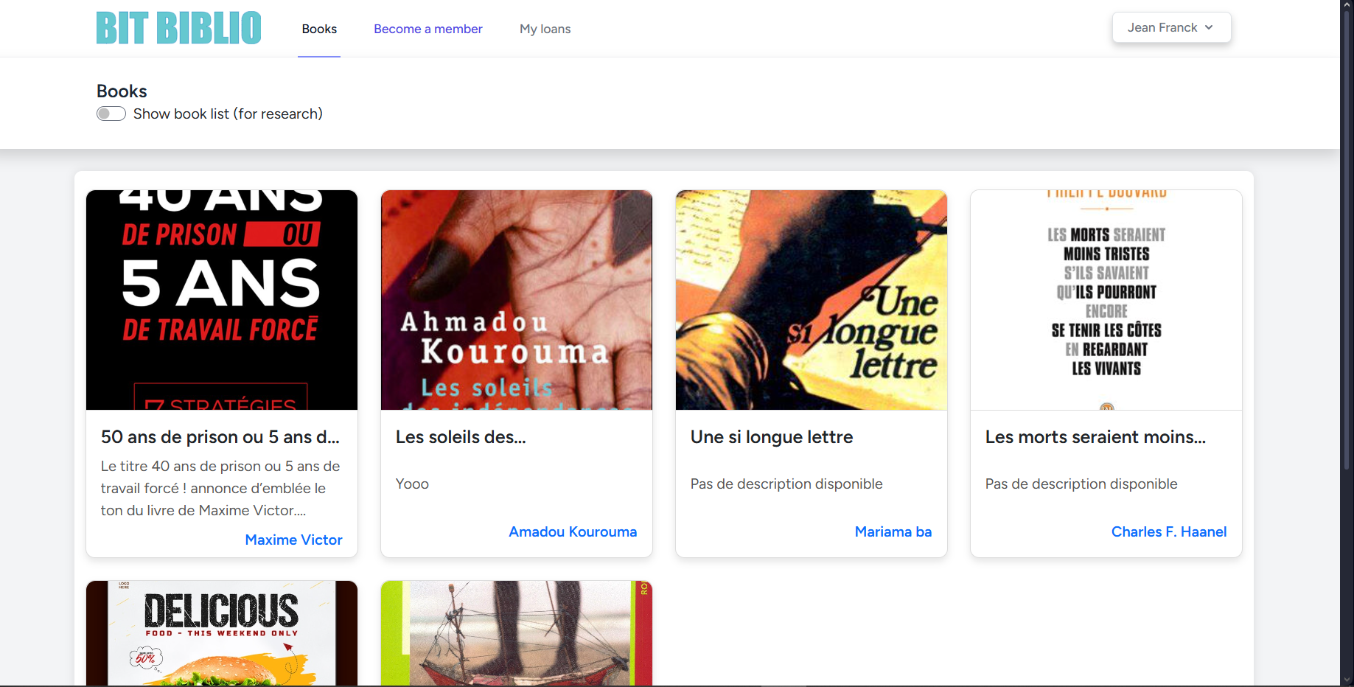
User view/BOOK

Slide 12
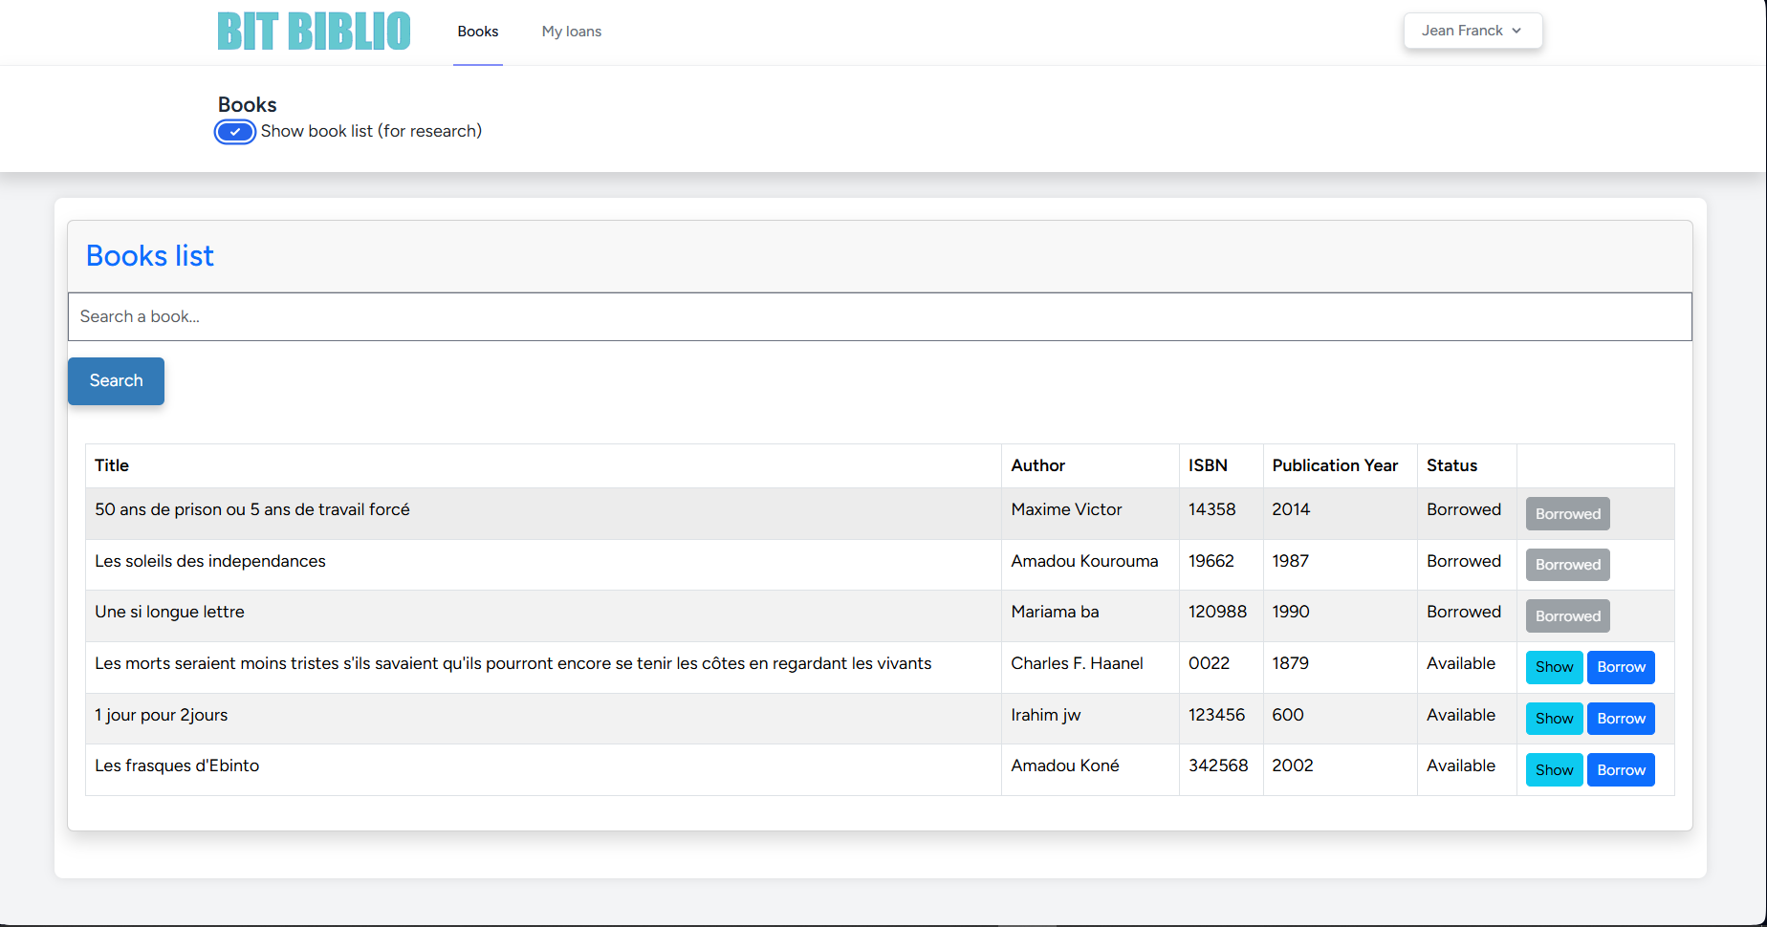
User view/ BOOK

Slide 13
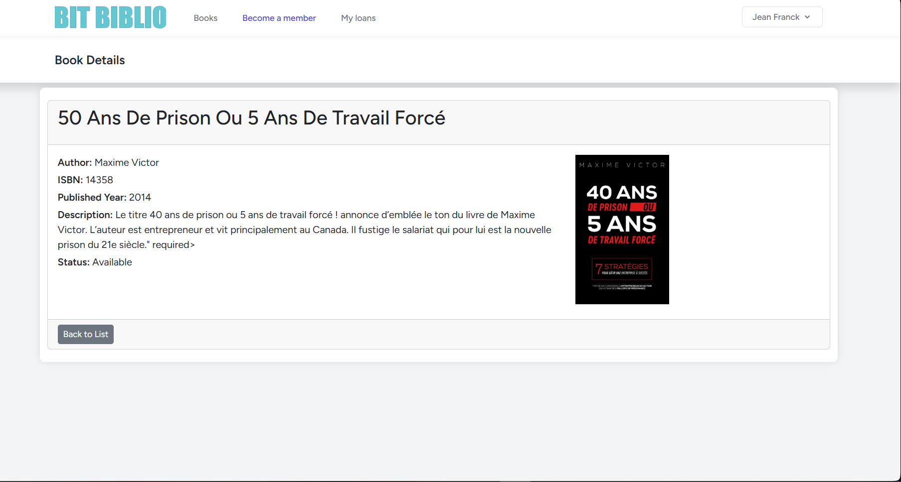
User view/ BOOK SHOW

Slide 14
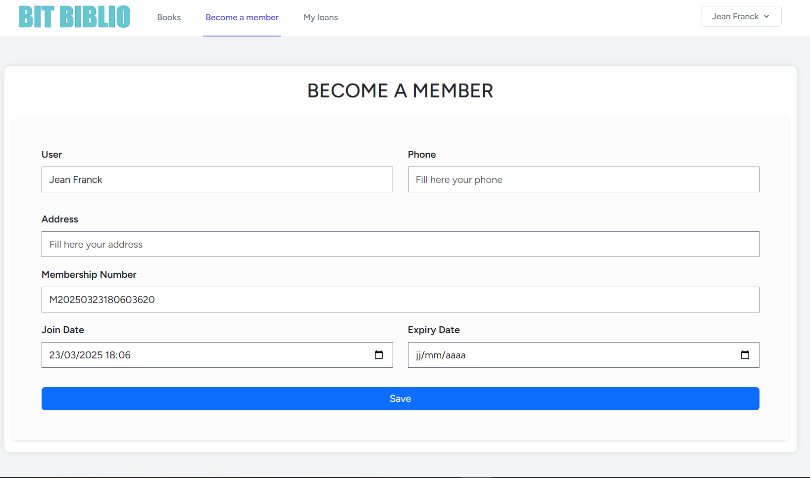
User view/ BECOME A MEMBER

Slide 15
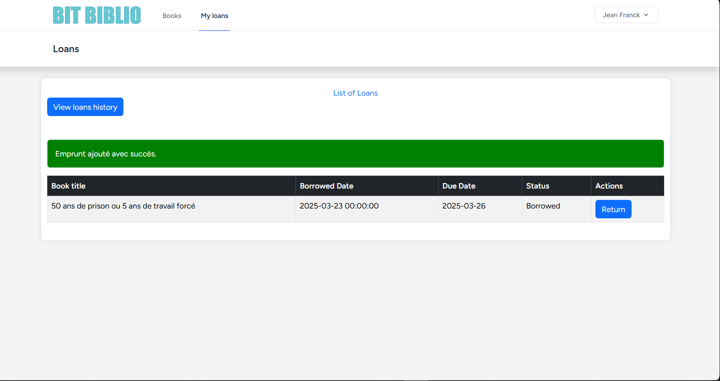
User view / LOAN

Slide 16
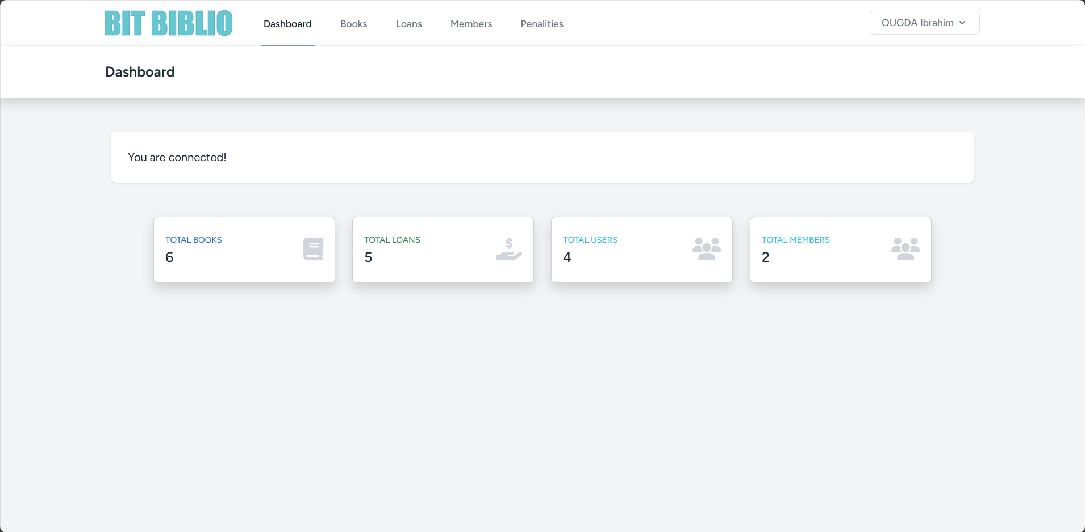
Admin view/DASHBOARD

Slide 17
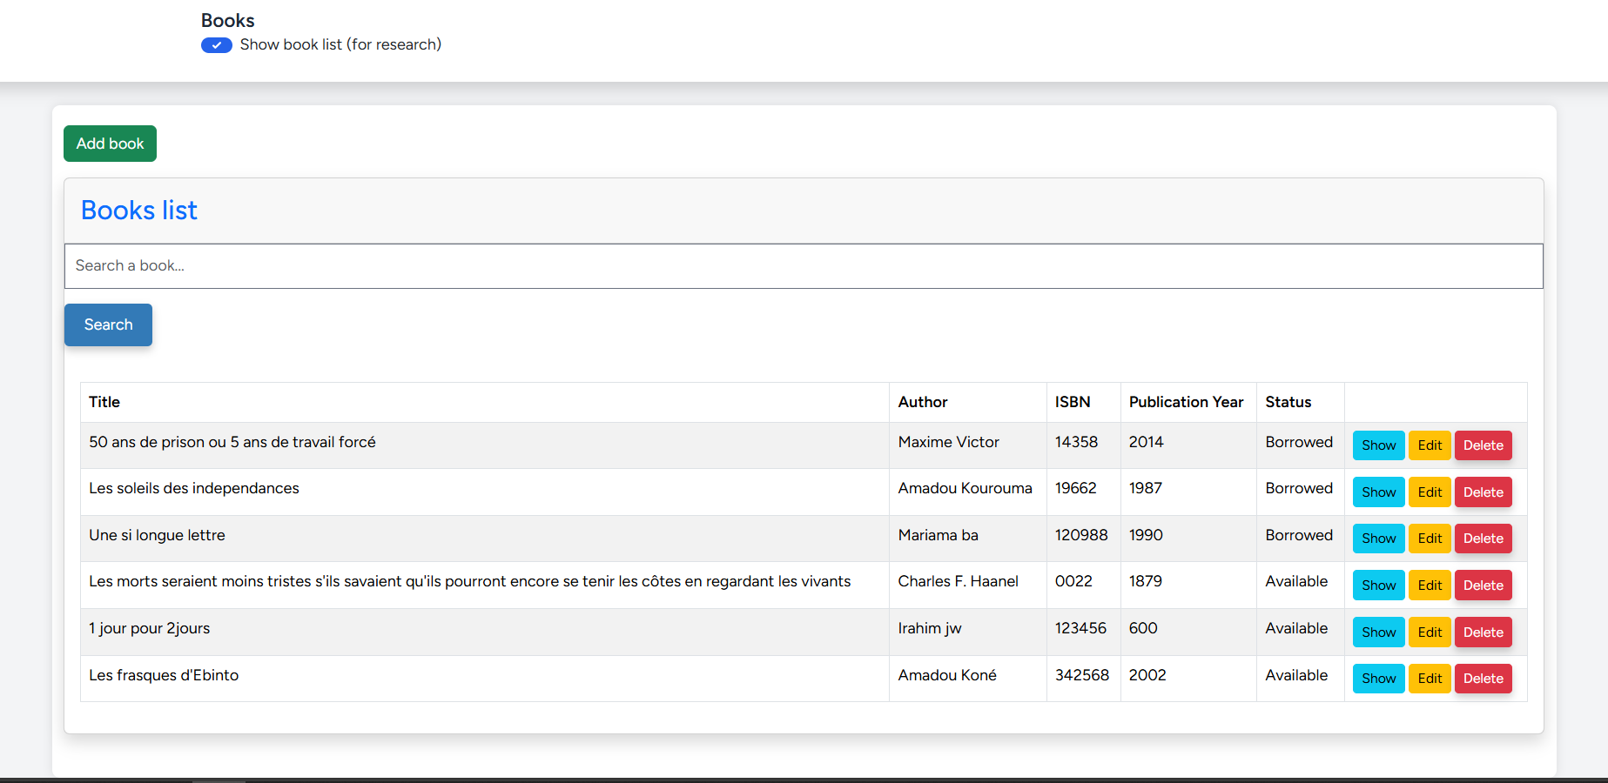
Admin view/BOOK

Slide 18
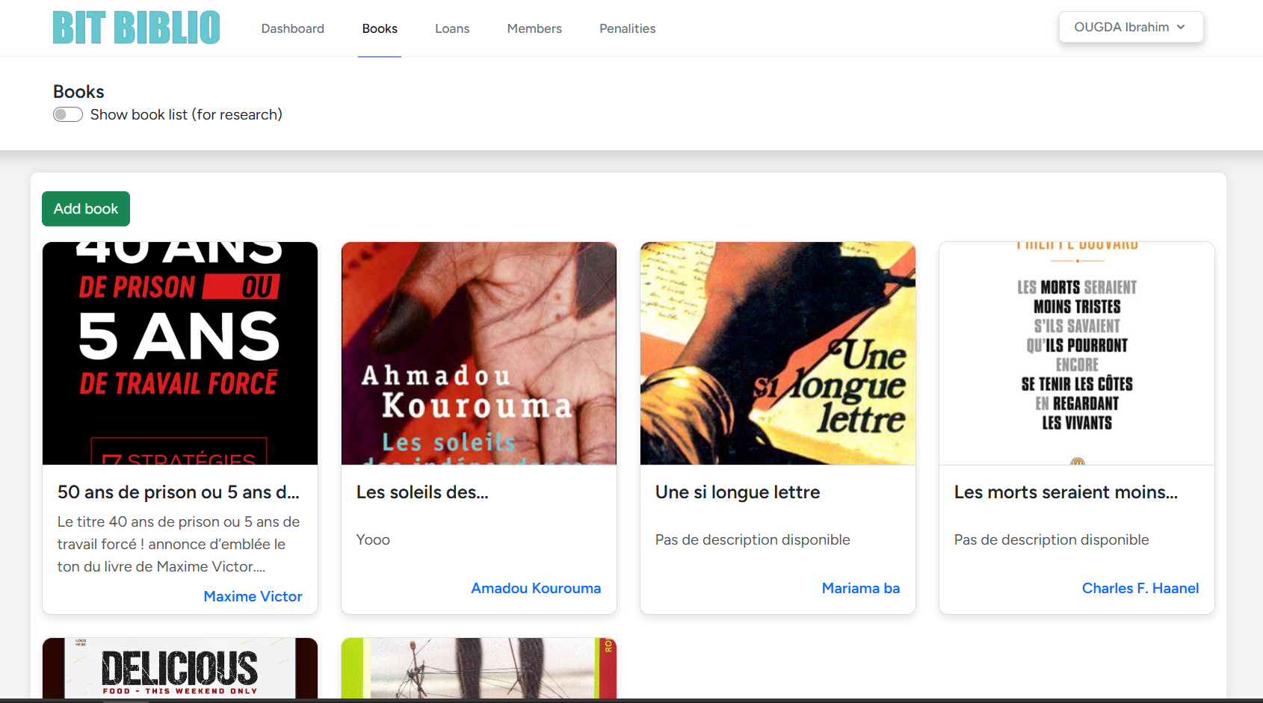
Admin view/BOOK

Slide 19
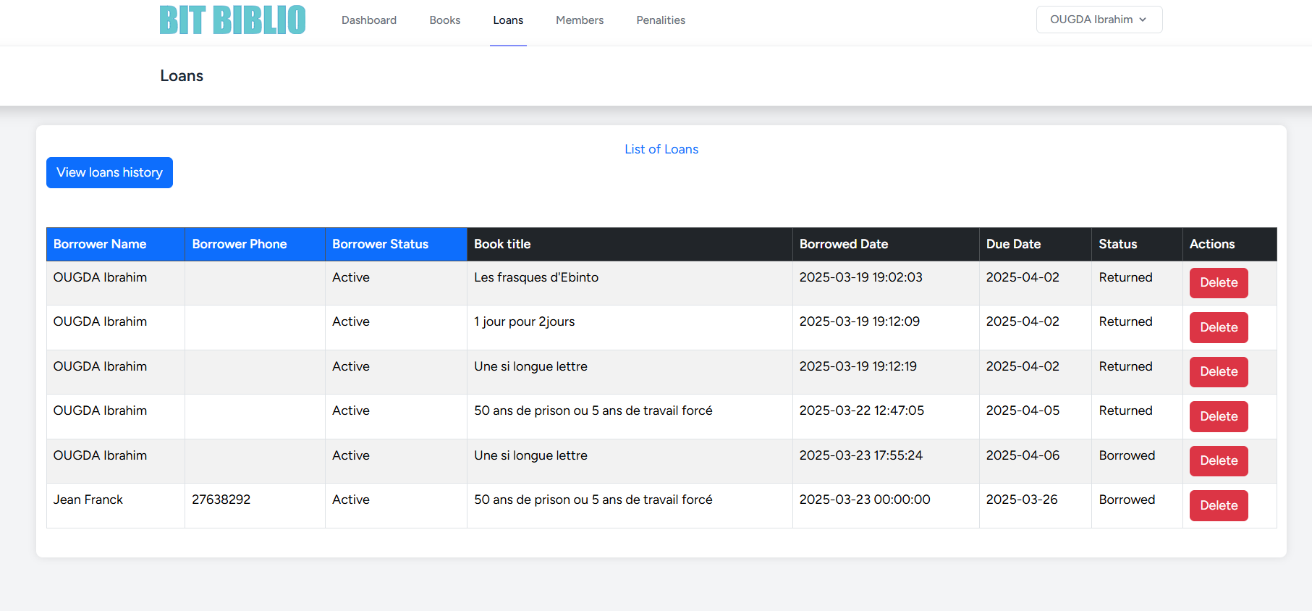
Admin view/LOAN

Slide 20
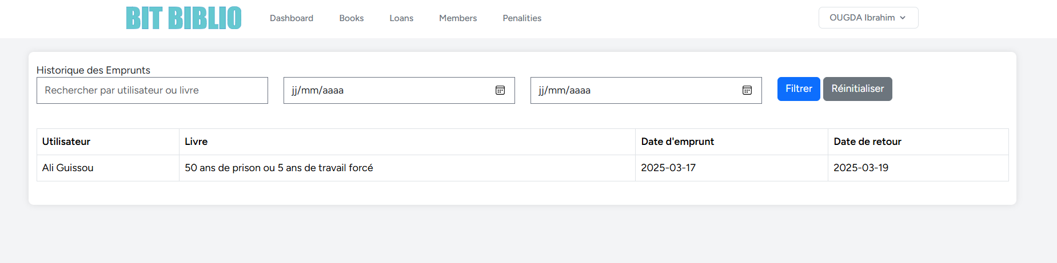
Admin view/LOANS History

Slide 21
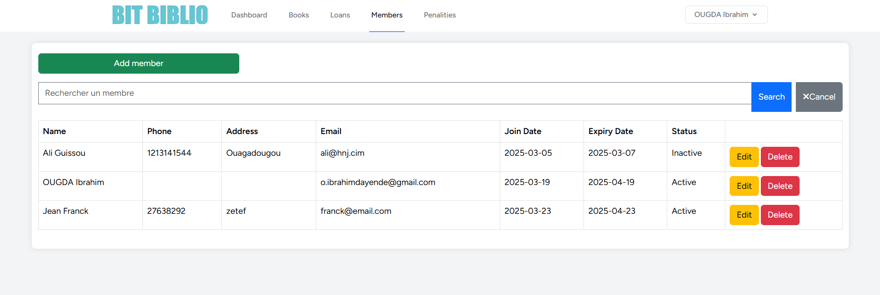
Admin view/ MEMBER

Slide 22
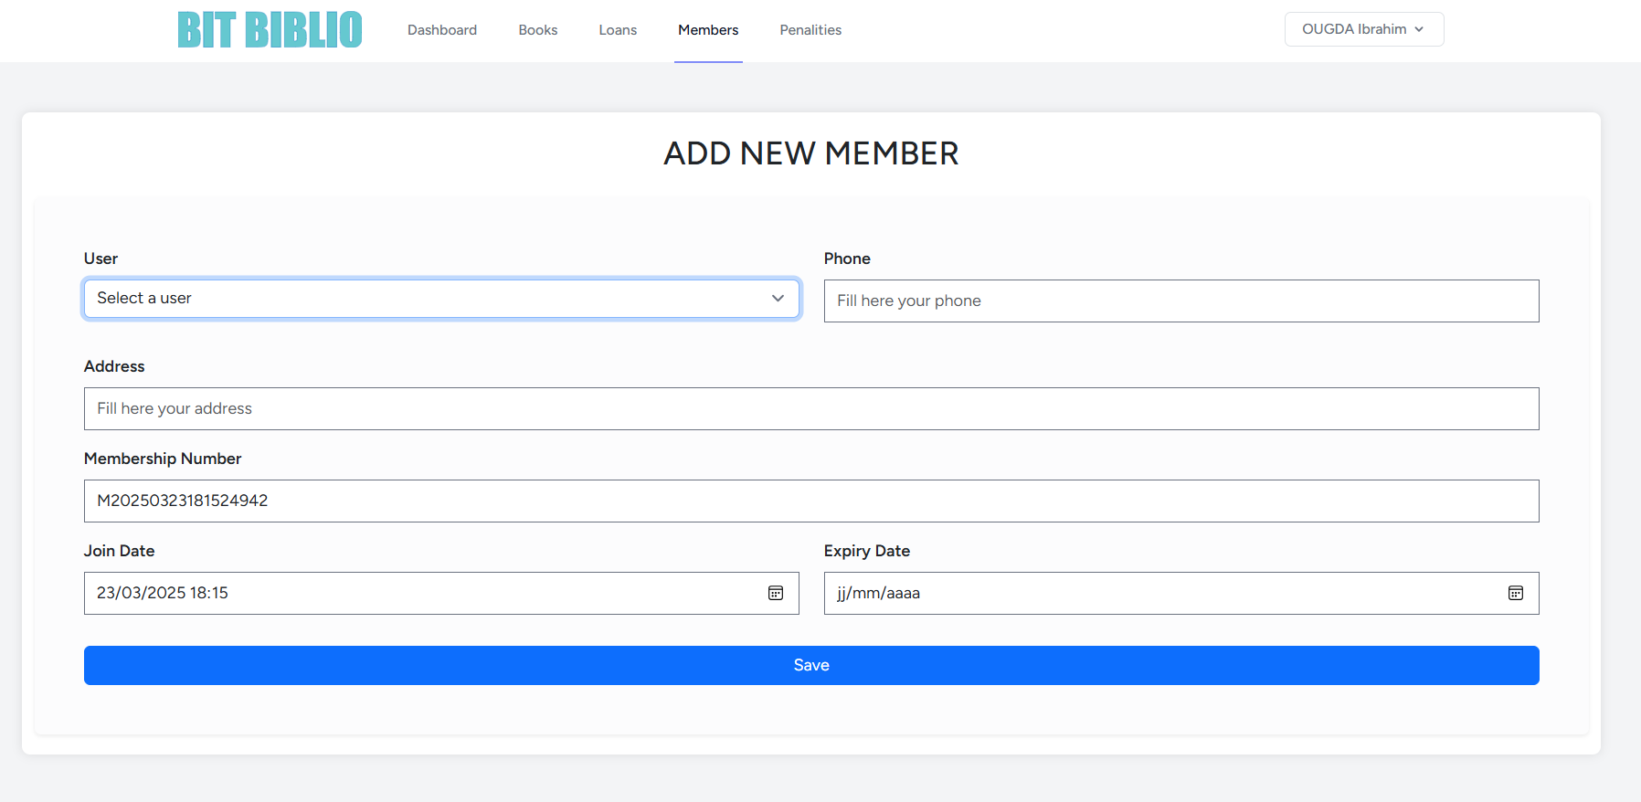
Admin view/ ADD MEMBER

Slide 23
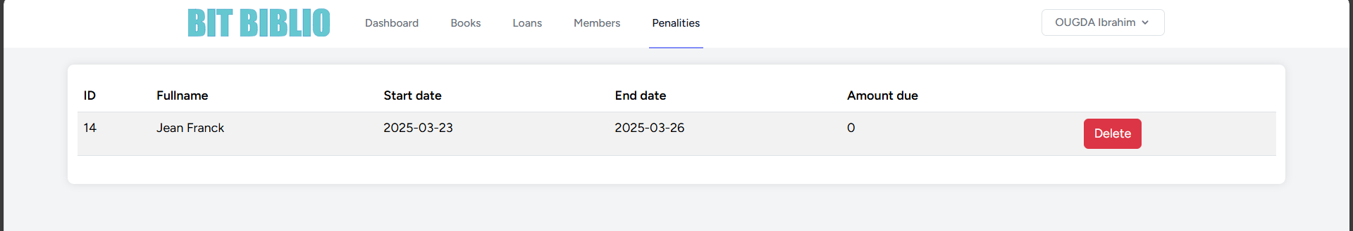
Admin view/ PENALTY

